Slide 1
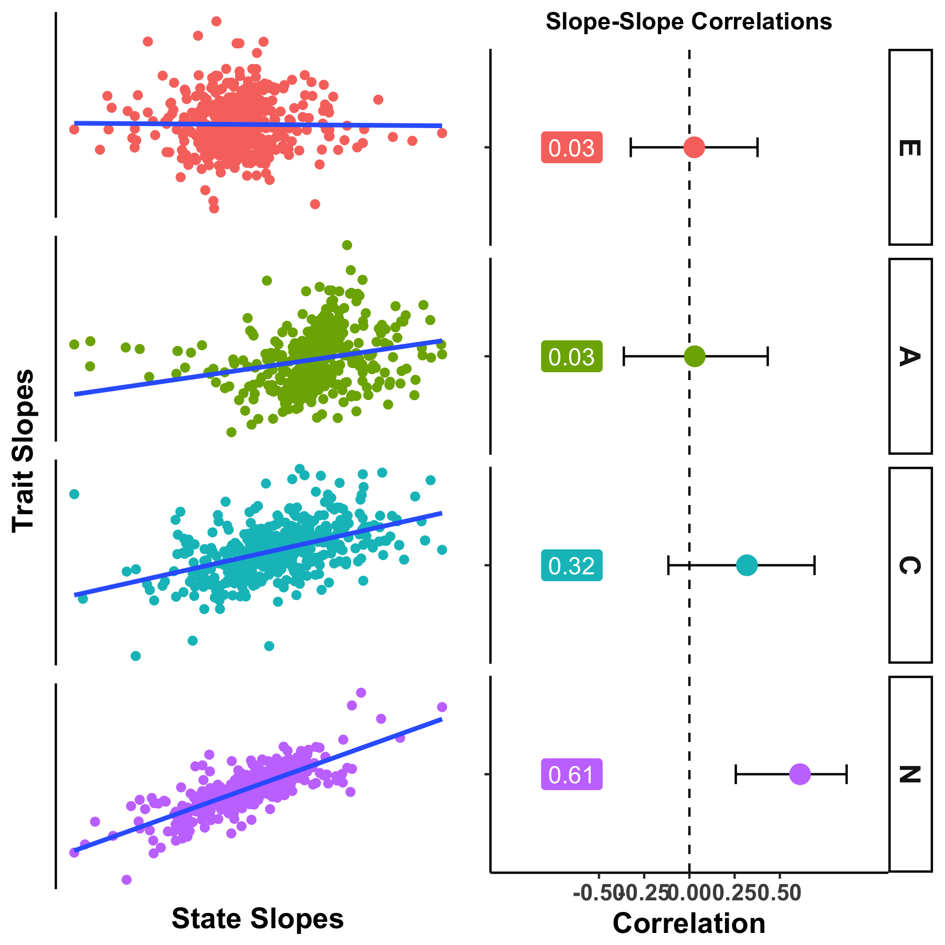

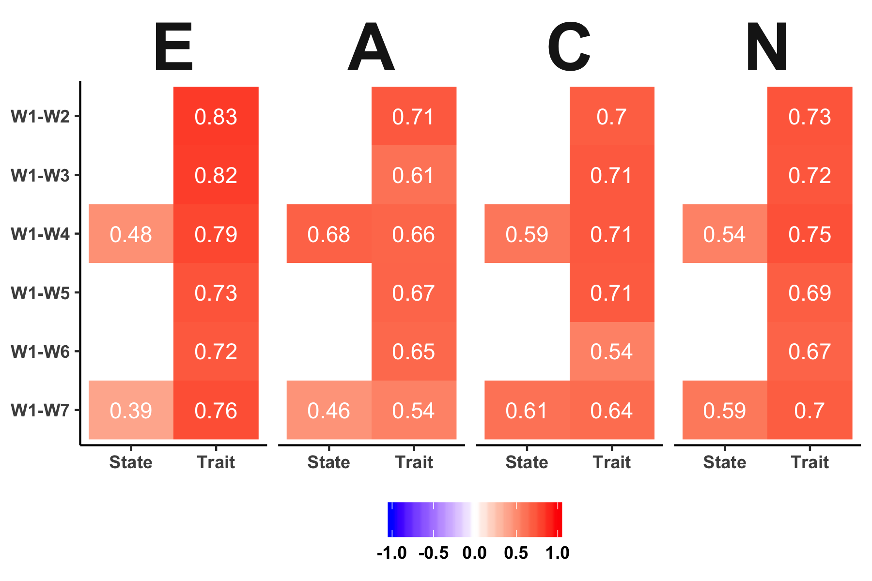
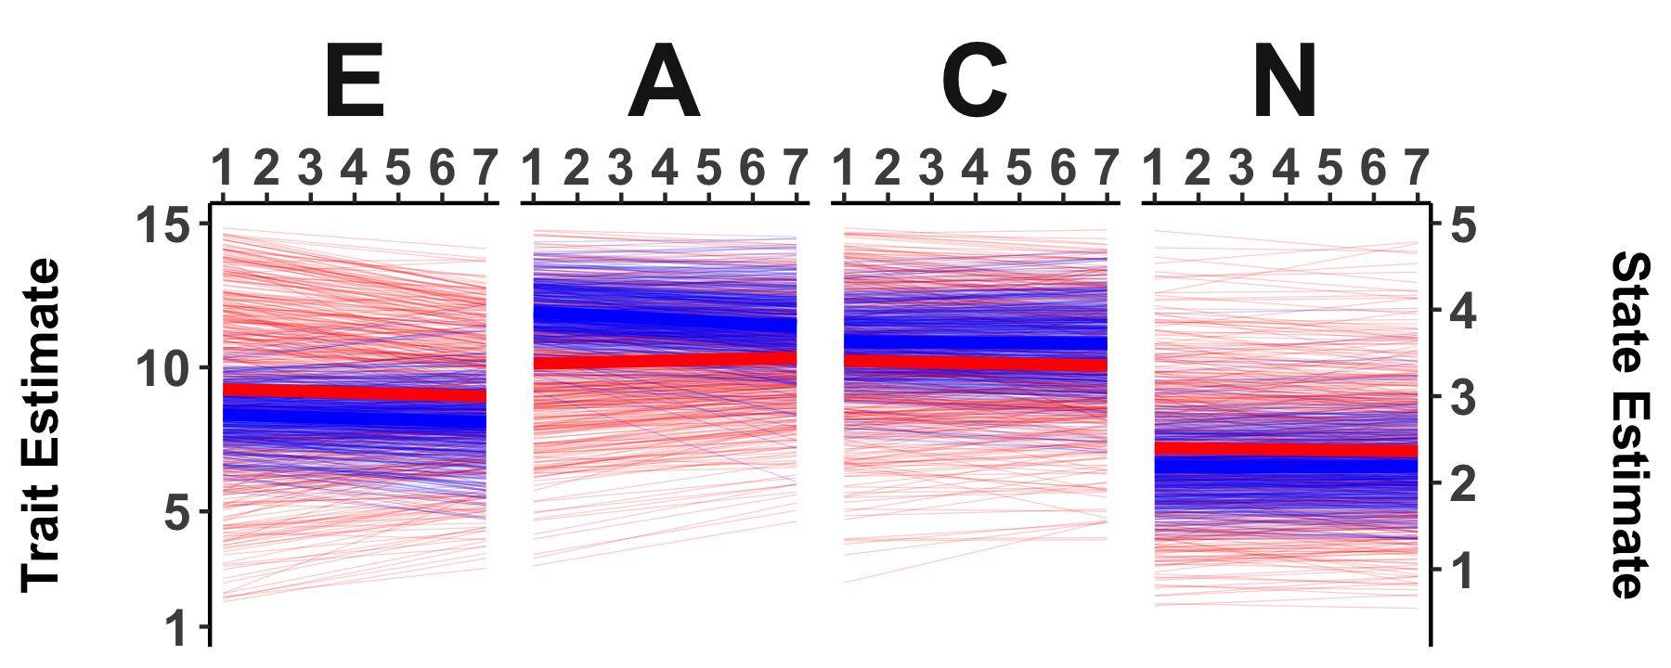
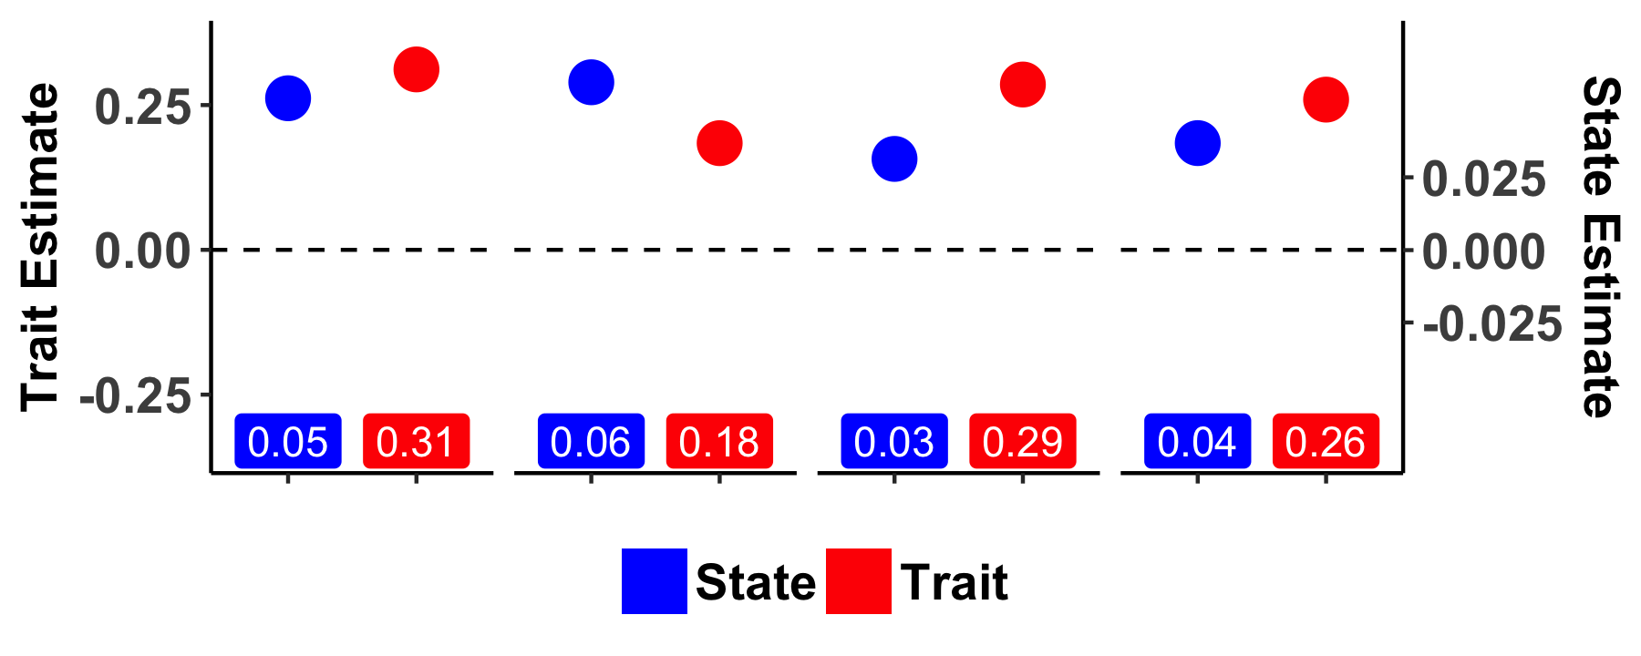
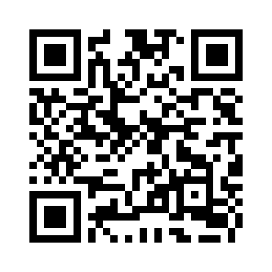
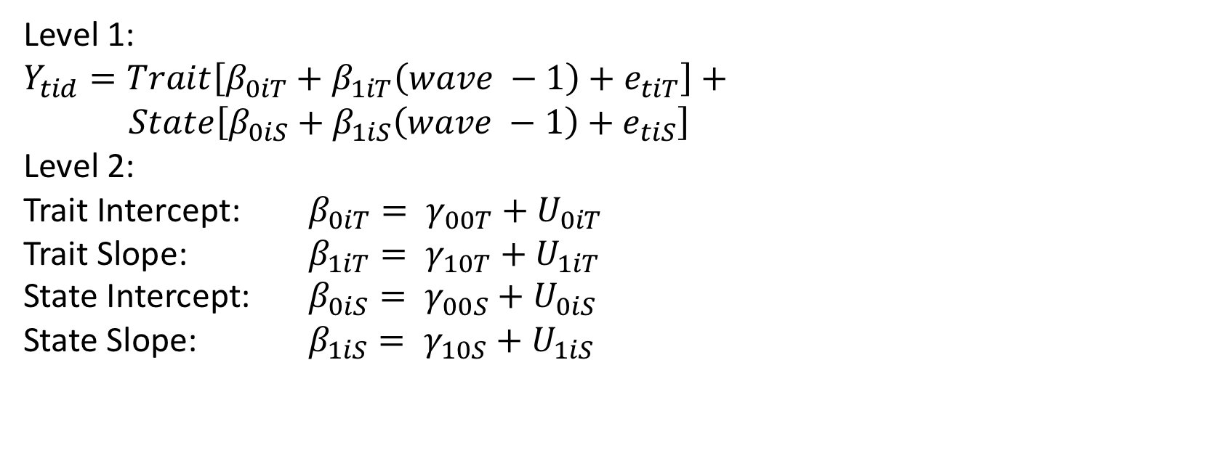
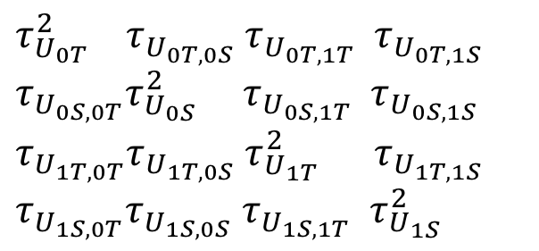
I Do What I Am or I Am What I Do?
Correlated Change in State and Trait Personality
Emorie D Beck
Washington University in St. Louis
Joshua J Jackson
Washington University in St. Louis
Introduction
Method (cont.)
Correlated Change
Longitudinal Personality Change
Level 1:
$$Y_{tid}=Trait\left[β_{0iT}+β_{1iT}\left(wave −1\right)+e_{tiT}\right]+$$
$State\left[β_{0iS}+β_{1iS}\left(wave −1\right)+e_{tiS}\right]$
Level 2:
Trait Intercept: $β_{0iT}= γ_{00T}+U_{0iT}$
Trait Slope: $β_{1iT}= γ_{10T}+U_{1iT}$
State Intercept: $β_{0iS}= γ_{00S}+U_{0iS}$
State Slope: $β_{1iS}= γ_{10S}+U_{1iS}$
State
Behaviors
$$τ_{U_{0T}}^{2} { τ}_{U_{0T,0S}}{ τ}_{U_{0T,1T}} τ_{U_{0T,1S}}$$
$$τ_{U_{0S,0T}}τ_{U_{0S}}^{2} { τ}_{U_{0S,1T}} τ_{U_{0S,1S}}$$
$$τ_{U_{1T,0T}}τ_{U_{1T,0S}}{ τ}_{U_{1T}}^{2} τ_{U_{1T,1S}}$$
$${τ_{U_{1S,0T}}τ_{U_{1S,0S}} τ_{U_{1S,1T}} τ}_{U_{1S}}^{2}$$
?
Test-Retest Consistency
Trait
Self-Knowledge
Is there stability in state measures across time?
Are there individual differences in change of state measures?
Are state and trait change associated with one another?
Conclusions
Method
Mean-Level Change
States can be used to measure personality change.
Mean-level change: not a lot in this sample
Variances: More variability in trait slopes → people think they are more mutable than they are
Correlate Change: Moderate slope-slope correlations → change isn’t just in your head
3 waves of ESM responses and 7 waves of survey responses from the Personality and Interpersonal Roles Study (PAIRS)
N = 434 Wash U undergrads,
Total ESM assessments N = 18,463 (median = 31 responses)
Total survey assessments N = 1301 (median = 3 responses)
Measures
9 items from the Big Five Inventory (BFI)
Procedure
State: 4 assessments / day for 15 days at 3 time points, 1 year apart
Trait: 1 assessment at 7 time points, 3 months apart
Total Assessment Period: 2 years
References
Extraversion
Agreeableness
Conscientiousness
Neuroticism
Haidt, J., & Algoe, S. (2004). Moral amplification and the emotions that attach us to saints and demons. Handbook of experimental existential psychology, 322-335.
Schwarz, N., & Clore, G. L. (1983). Mood, misattribution, and judgments of well-being: informative and directive functions of affective states. Journal of personality and social psychology, 45(3), 513.
Schwarz, N., & Clore, G. L. (2003). Mood as information: 20 years later. Psychological Inquiry, 14(3-4), 296-303.
Tiedens, L. Z., & Linton, S. (2001). Judgment under emotional certainty and uncertainty: the effects of specific emotions on information processing. Journal of personality and social psychology, 81(6), 973.
Contract / Grant Sponsor: Office of Naval Research, Contract / Grant Number: ONR BAA 12-001
Poster, Data, & Code
Trait_{T1}
Trait_{T2}
Trait_{T3}
Trait_{T4}
Trait_{T5}
Trait_{T6}
Trait_{T7}
2 Years
State_{T1}
State_{T4}
State_{T7}

